Slide 1
Importance of Project Procurement Management
Why Outsource?
Contracts types of contracts
Project procurement management processes
Documentation involving procurement
Best practices

Slide 2
Importance of Project Procurement Management
Procurement means acquiring goods and/or services from an outside source
Other terms include purchasing and outsourcing
Experts predict that global spending on computer software and services will continue to grow
People continue to debate whether offshore outsourcing helps their own country or not
B12 Project Management

Slide 3
Debates on Outsourcing
Some companies, such as Wal-Mart, prefer to do no outsourcing at all, while others do a lot of outsourcing. GM recently announced plans to switch from outsourcing 90% of IT service to only 10%
Most organizations do some form of outsourcing to meet their IT needs and spend most money within their own country
The U.S. temporary workforce continues to grow as people work for temporary job agencies so they can more easily move from company to company
B12 Project Management

Slide 4
IT Outsourcing Market Continues to Grow
U.S. companies are transferring more work abroad, especially in the areas of IT infrastructure, application development and maintenance, and innovation processes
India, China, and the Philippines are the preferred locations for outsourcing, and Latin America is growing in popularity
A shortage of qualified personnel, not cost savings, is the top reason for global outsourcing of IT services
B12 Project Management

Slide 5
Why Outsource?
To access skills and technologies
To reduce both fixed and recurrent costs
To allow the client organization to focus on its core business
To provide flexibility
To increase accountability
B12 Project Management

Slide 6
Contracts
A contract is a mutually binding agreement that obligates the seller to provide the specified products or services and obligates the buyer to pay for them
Contracts can clarify responsibilities and sharpen focus on key deliverables of a project
Because contracts are legally binding, there is more accountability for delivering the work as stated in the contract
A recent trend in outsourcing is the increasing size of contracts
B12 Project Management

Slide 7
Project Procurement Management : Processes required to acquire goods and services from outside the organization.
Processes
  Procurement Planning
  Solicitation Planning
  Solicitation
  Source Selection
  Contract Administration
  Contract Close-out

Slide 8
Project Procurement Management Processes
Planning | Executing | Controlling | Closing
Procurement Planning
Solicitation Planning | Solicitation
 | Source Selection
 | Contract Administration |  | Contract Close-out

Slide 9
Proc. Mgmt : Procurement Planning : Concepts
Buyer – The customer.
Seller – Contractor; vendor; supplier external to the performing organization.
The terms and conditions of the contract become key inputs to many of the seller’s processes.

Slide 10
Proc. Mgmt : Procurement Planning
Determining what project needs can best be met by procuring products or services outside the organization.

Slide 11
Proc. Mgmt : Procurement Planning
Inputs | Tools and techniques | Outputs
Scope statement | Make-or-buy analysis | Procurement management plan
Product description | Expert judgment | Statement of work
Procurement resources | Contract type selection
Market conditions
Other planning outputs
Constraints
Assumptions

Slide 12
Proc. Mgmt : Procurement Planning : Inputs
Scope statement – Current project boundaries.
Product description – The product of the project.
Procurement resources – The resources and expertise needed for procurement activities.
Market conditions – What products and services are available in the marketplace.
Other planning outputs – Cost and schedule estimates, quality plans.

Slide 13
Proc. Mgmt : Procurement Planning : Tools & Tech.
Make-or-buy analysis – Both direct and indirect costs. Project need and urgency.
Expert judgment
Contract type selection – Type of contract that the purchase would be.
  Fixed price (lump sum) contracts
  Cost-reimbursable contracts
  Time and material contracts

Slide 14
Proc. Mgmt : Procurement Planning : Outputs
Procurement Management Plan – Describes how the remaining procurement processes will be handled.
  Types of contracts used
  Managing multiple providers
  How procurement will be coordinated
  Standardized documents used.
Statement of work (SOW) – Describes the procurement item in sufficient detail to allow prospective sellers to determine if they are capable of providing the item. (Should be as clear, complete and as concise as possible).

Slide 15
Proc. Mgmt : Solicitation Planning
Solicitation planning involves preparing the documents needed to support solicitation.

Slide 16
Proc. Mgmt : Solicitation Planning
Inputs | Tools and techniques | Outputs
Procurement Mgmt. Plan | Standard forms | Procurement documents
Statement of work | Expert judgment | Evaluation criteria
Other planning outputs |  | Statement of work updates

Slide 17
Proc. Mgmt : Solicitation Planning : Inputs
Procurement Mgmt. Plan
Statement of work
Other planning outputs

Slide 18
Proc. Mgmt : Solicitation Planning : Tools & Tech.
Standard forms – Standard contracts, item descriptions or standardized versions of bid documents.
Expert Judgment

Slide 19
Proc. Mgmt : Solicitation Planning : Outputs
Procurement documents – Used to solicit proposals from prospective sellers.
  Invitation for bid (IFB)
  Request for proposal (RFP)
  Request for quotation (RFQ)
  Invitation for negotiation (IFN)
Evaluation criteria – Used to rate or score proposals. Judge sellers ability to satisfy need.
Statement of work updates

Slide 20
Proc. Mgmt : Solicitation
Obtaining responses (bids and proposals) from prospective sellers on how project needs can be met.
Note : Much of the effort in this process is expended by the prospective seller, at little or no cost to the project.

Slide 21
Proc. Mgmt : Solicitation
Inputs | Tools and techniques | Outputs
Procurement documents | Bidder conferences | Proposals
Qualified seller lists | Advertising

Slide 22
Proc. Mgmt : Solicitation : Inputs
Procurement documents – Produced by the Solicitation Planning process.
Qualified seller lists – Based on past experience and specialist skills.

Slide 23
Proc. Mgmt : Solicitation : Tools & Tech.
Bidder conferences – Bidder conferences are meetings with prospective sellers prior to the preparation of a proposal.
Advertising – Identify potential sellers by placing advertisements. Mandatory for some contracts.

Slide 24
Proc. Mgmt : Solicitation : Outputs
Proposals – Proposals are seller prepared documents that describe the sellers ability and willingness to provide the requested product.

Slide 25
Proc. Mgmt : Source Selection
Receiving the bids or proposals and applying the evaluation criteria to select a provider.

Slide 26
Proc. Mgmt : Source Selection
Inputs | Tools and techniques | Outputs
Proposals | Contract negotiation | Contract
Evaluation criteria | Weighting system
Organizational policies | Screening system
 | Independent estimates

Slide 27
Proc. Mgmt : Source Selection : Inputs
Proposals
Evaluation criteria
Organizational policies – The existing policies within the organization to evaluate proposals should be consulted.

Slide 28
Proc. Mgmt : Source Selection : Tools & Tech.
Contract negotiation – Clarification and mutual agreement of the structure and requirements of the contract prior to signing.
Weighting system – Scoring system by assigning points for qualitative data.
Screening system – Establishing minimum requirements for any of the evaluation criteria.
Independent estimates – Used as a check on the vendor estimate (a.k.a. “should cost”)

Slide 29
Proc. Mgmt : Source Selection : Outputs
Contract – Mutually binding agreement that obligates the seller to provide the specified service and the buyer to pay for it. (Is a legal relationship subject to remedy in court).
Also be called,
  License agreement
  Subcontract
  Purchase order
  Memorandum of understanding (MOU)

Slide 30
Proc. Mgmt : Contract Administration
Ensuring the seller’s performance meets contractual requirements.
Given the legal nature of a contract, the project team must be aware of the legal implications of actions taken.

Slide 31
Proc. Mgmt : Contract Administration
Inputs | Tools and techniques | Outputs
Contract | Contract change control system | Correspondence
Work results | Performance reporting | Contract changes
Change requests | Payment system | Payment requests
Seller invoices

Slide 32
Proc. Mgmt : Contract Administration : Inputs
Contract
Work results – The sellers work results. Deliverables completed and not met.
Change requests – Modification to the terms of the contract or to the service provided.
Seller invoices – Seller’s requests for payment for work performed. Invoicing procedures and defined in the contract.

Slide 33
Proc. Mgmt : Contract Administration : Tools & Tech.
Contract change control system – Process by which the contract may be modified.
Performance reporting – Provides management with information how well the seller is achieving the contractual objectives.
Payment system – Payment to the seller. Must include appropriate reviews and approvals by the project management team.

Slide 34
Proc. Mgmt : Contract Administration : Outputs
Correspondence– Contract clarifications, warnings of poor performance.
Contract changes
Payment requests – Initiate payment to the seller based on performance.

Slide 35
Proc. Mgmt : Contract Closeout
Completion and settlement of the contract, including resolution of any open items.
Involves both product verification (was all the work done satisfactorily?) and administrative closeout (update and archive records).

Slide 36
Proc. Mgmt : Contract Closeout
Inputs | Tools and techniques | Outputs
Contract documentation | Procurement audits | Contract file
 |  | Formal acceptance and closure

Slide 37
Proc. Mgmt : Contract Closeout : Inputs
Contract documentation Includes, but not limited to,
  Contract
  Supporting schedules
  Requested and approved contract changes
  Seller-developed technical documentation
  Seller performance reports
  Financial documents (e.g., invoices and payment records)

Slide 38
Proc. Mgmt : Contract Closeout : Tools & Tech.
Procurement audits - Structured reviews of the procurement process, from procurement planning through contract administration.
Conducted to identify successes and failures for the knowledge of the organization.

Slide 39
Proc. Mgmt : Contract Closeout : Outputs
Contract file – A complete set of indexed records, prepared for inclusion with the final project records.
Formal acceptance and closure – Person or organization responsible for contract administration provides the seller with formal written notice that the contract has been completed.

Slide 40
Project Procurement Management - Summary
Processes required to acquire goods and services from outside the organization.
Processes
  Procurement Planning
  Solicitation Planning
  Solicitation
  Source Selection
  Contract Administration
  Contract Close-out

Slide 41
Contents/Clauses in a Contract
Clauses in a Contract
  Buyer, seller definitions
  Scope of responsibilities
  Price determination, payment schedules
  Contract changes/approval levels
  Steps for terminating the contract
  Penalties for delays
  Subcontracts
  Performance bonds, insurance concerns
  Notices, inspections and related costs

Slide 42
Elements for a contract to be Enforceable
Elements for a contract to be enforceable
  Legal capacity to do so
  Signature of authority
  Mutual assent to contract
  Clearly defined terms
  Not under duress or coercion
  Must not be illegal or against public policy
  Be in an appropriate form

Slide 43
Project Procurement Management Processes
Project procurement management: Acquiring goods and services for a project from outside the performing organization
Processes include:
  Planning procurement management: Determining what to procure and when and how to do it
  Conducting procurements: Obtaining seller responses, selecting sellers, and awarding contracts
  Controlling procurements: Managing relationships with sellers, monitoring contract performance, and making changes as needed
  Closing procurements: Completing and settling each contract or agreement, including resolving of any open items
B12 Project Management

Slide 44
Project Procurement Management Processes
Procurement planning: determining what to procure and when
Solicitation planning: documenting product requirements and identifying potential sources
Solicitation: obtaining quotations, bids, offers, or proposals as appropriate
Source selection: choosing from among potential vendors
Contract administration: managing the relationship with the vendor
Contract close-out: completion and settlement of the contract
B12 Project Management

Slide 45
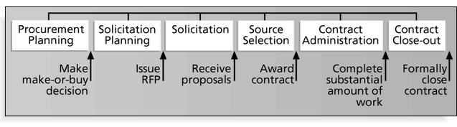
Project Procurement Management Processes and Key Outputs
B12 Project Management

Slide 46
Procurement Planning
Procurement planning involves identifying which project needs can be best met by using products or services outside the organization. It includes deciding
  whether to procure
  how to procure
  what to procure
  how much to procure
  when to procure
B12 Project Management

Slide 47
Procurement Planning Tools and Techniques
Make-or-buy analysis: determining whether a particular product or service should be made or performed inside the organization or purchased from someone else. Often involves financial analysis
Experts, both internal and external, can provide valuable inputs in procurement decisions
B12 Project Management

Slide 48
Make-or Buy Example
Assume you can lease an item you need for a project for $150/day. To purchase the item, the investment cost is $1,000, and the daily cost would be another $50/day.
How long will it take for the lease cost to be the same as the purchase cost?
If you need the item for 12 days, should you lease it or purchase it?
B12 Project Management

Slide 49
Make-or Buy Solution
Set up an equation so the “make” is equal to the “buy”
In this example, use the following equation. Let d be the number of days to use the item.
  $150d = $1,000 + $50d
Solve for d as follows:
  Subtract $50d from the right side of the equation to get
  $100d = $1,000
  Divide both sides of the equation by $100
  d = 10 days
The lease cost is the same as the purchase cost at 10 days
If you need the item for 12 days, it would be more economical to purchase it
B12 Project Management

Slide 50
Types of Contracts
Different types of contracts can be used in different situations:
  Fixed price or lump sum contracts: Involve a fixed total price for a well-defined product or service
  Cost reimbursable contracts: Involve payment to the seller for direct and indirect costs
  Time and material contracts: Hybrid of both fixed price and cost reimbursable contracts, often used by consultants
  Unit price contracts: Require the buyer to pay the seller a predetermined amount per unit of service
A single contract can actually include all four of these categories, if it makes sense for that particular procurement
B12 Project Management

Slide 51
Cost Reimbursable Contracts
Cost plus incentive fee (CPIF): The buyer pays the supplier for allowable performance costs plus a predetermined fee and an incentive bonus
Cost plus fixed fee (CPFF): The buyer pays the supplier for allowable performance costs plus a fixed fee payment usually based on a percentage of estimated costs
Cost plus percentage of costs (CPPC): The buyer pays the supplier for allowable performance costs plus a predetermined percentage based on total costs
B12 Project Management

Slide 52
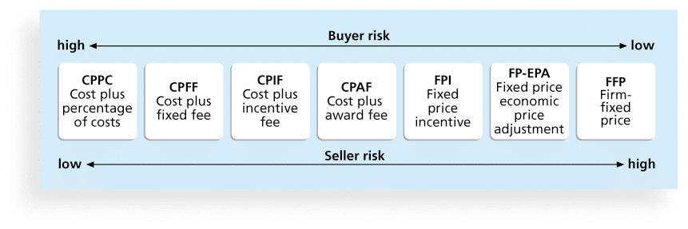
Figure 12-2. Contract Types Versus Risk
B12 Project Management

Slide 53
Contract Types
Contract Types
  Cost Plus Percentage of Cost (CPPC)
  Cost Plus Fixed Fee (CPFF)
  Cost Plus Incentive Fee (CPIF)
  Fixed Price Incentive (FPI)
  Firm Fixed Price (FFP)
Buyer’s risk high
Seller’s risk high

Slide 54
Contract Clauses
Contracts should include specific clauses to take into account issues unique to the project
Can require various educational or work experience for different pay rights
A termination clause is a contract clause that allows the buyer or supplier to end the contract
B12 Project Management

Slide 55
Procurement Management Plan
Describes how the procurement processes will be managed, from developing documentation for making outside purchases or acquisitions to contract closure
Contents varies based on project needs
B12 Project Management

Slide 56
Contract Statement of Work (SOW)
A statement of work is a description of the work required for the procurement
If a SOW is used as part of a contract to describe only the work required for that particular contract, it is called a contract statement of work
A SOW is a type of scope statement
A good SOW gives bidders a better understanding of the buyer’s expectations
B12 Project Management

Slide 57
Procurement Documents
Request for Proposals: Used to solicit proposals from prospective sellers
  A proposal is a document prepared by a seller when there are different approaches for meeting buyer needs
Requests for Quotes: Used to solicit quotes or bids from prospective suppliers
  A bid, also called a tender or quote (short for quotation), is a document prepared by sellers providing pricing for standard items that have been clearly defined by the buyer
B12 Project Management

Slide 58
Source Selection Criteria
It’s important to prepare some form of evaluation criteria, preferably before issuing a formal RFP or RFQ
Beware of proposals that look good on paper; be sure to evaluate factors, such as past performance and management approach
Can require a technical presentation as part of a proposal
B12 Project Management

Slide 59
Conducting Procurements
Deciding whom to ask to do the work
Sending appropriate documentation to potential
sellers
Obtaining proposals or bids
Selecting a seller
Awarding a contract
B12 Project Management

Slide 60
Approaches for Procurement
Organizations can advertise to procure goods and services in several ways:
  Approaching the preferred vendor
  Approaching several potential vendors
  Advertising to anyone interested
A bidders’ conference can help clarify the buyer’s expectations
B12 Project Management

Slide 61
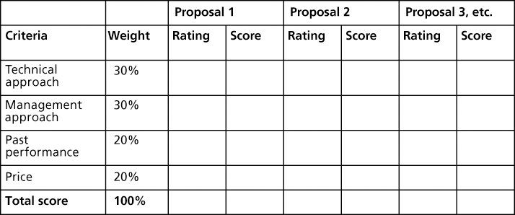
Figure 12-5. Sample Proposal Evaluation Sheet
B12 Project Management

Slide 62
Seller Selection
Organizations often do an initial evaluation of all proposals and bids and then develop a short list of potential sellers for further evaluation
Sellers on the short list often prepare a best and final offer (BAFO)
Final output is a contract signed by the buyer and the selected seller
B12 Project Management

Slide 63
Controlling Procurements
Ensures that the seller’s performance meets contractual requirements
Contracts are legal relationships, so it is important that legal and contracting professionals be involved in writing and administering contracts
It is critical that project managers and team members watch for constructive change orders, which are oral or written acts or omissions by someone with actual or apparent authority that can be construed to have the same effect as a written change order
B12 Project Management

Slide 64
Global Issues
A recent trend is to hire people in rural areas of the same country to perform work, often at less cost. Rural sourcing uses two simple premises: Smaller towns need jobs, and workers there often charge 25 to 50 percent less than their urban counterparts.
  Onshore Technology Services recruits workers from low-paying jobs and gives them intensive training in IT specialties. The company employs 65 people in IT centers in the rural Missouri towns of Macon, Lebanon, and Joplin
  CrossUSA recruits older IT workers who are nearing retirement and want to enjoy a small-town quality of life. The company has 100 employees in Sebeka, Minnesota (population 700) and Eveleth, Minnesota (population 3,000)
B12 Project Management

Slide 65
Suggestions for Change Control in Contracts
Changes to any part of the project need to be reviewed, approved, and documented by the same people in the same way that the original part of the plan was approved
Evaluation of any change should include an impact analysis. How will the change affect the scope, time, cost, and quality of the goods or services being provided?
Changes must be documented in writing. Project team members should also document all important meetings and telephone phone calls
B12 Project Management

Slide 66
Suggestions for Change Control in Contracts (cont’d)
Project managers and teams should stay closely involved to make sure the new system will meet business needs and work in an operational environment
Have backup plans
Use tools and techniques, such as a contract change control system, buyer-conducted performance reviews, inspections and audits, and so on
B12 Project Management

Slide 67
Best Practice
Accenture developed a list of best practices from experienced outsourcers throughout the world:
  Build in Broad Business Outcomes Early and Often
  Hire a Partner, Not Just a Provider
  It’s More Than a Contract, It’s a Business Relationship
  Leverage Gain-Sharing
  Use Active Governance
  Assign a Dedicated Executive
  Focus Relentlessly on Primary Objectives
B12 Project Management

Slide 68
Closing Procurements
Involves completing and settling contracts and resolving any open items
The project team should:
    Determine if all work was completed correctly and satisfactorily
    Update records to reflect final results
    Archive information for future use
The contract itself should include requirements for formal acceptance and closure
B12 Project Management

Slide 69
Tools to Assist in Contract Closure
Procurement audits identify lessons learned in the procurement process
Negotiated settlements help close contracts more smoothly
A records management system provides the ability to easily organize, find, and archive procurement-related documents
B12 Project Management

Slide 70

Further details on procurement

Slide 71
Using Software to Assist in Project Procurement Management
Word processing software helps write proposals and contracts, spreadsheets help evaluate suppliers, databases help track suppliers, and presentation software helps present procurement-related information
E-procurement software does many procurement functions electronically
Organizations also use other Internet tools to find information on suppliers or auction goods and services
B12 Project Management

Slide 72
Statement of Work (SOW)
A statement of work is a description of the work required for the procurement
Many contracts, or mutually binding agreements, include SOWs
A good SOW gives bidders a better understanding of the buyer’s expectations
B12 Project Management

Slide 73
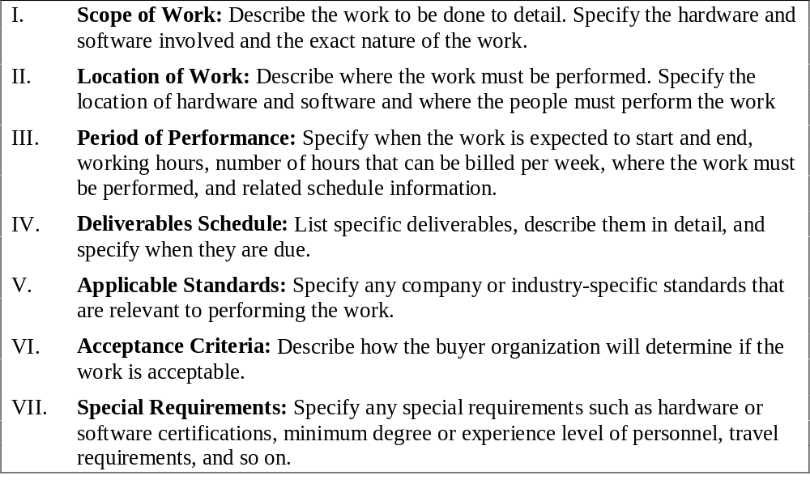
Statement of Work (SOW) Template
B12 Project Management

Slide 74
Solicitation Planning
Solicitation planning involves preparing several documents:
  Request for Proposals: used to solicit proposals from prospective sellers
  Requests for Quotes: used to solicit quotes for well-defined procurements
  Invitations for bid or negotiation and initial contractor responses are also part of solicitation planning
B12 Project Management

Slide 75
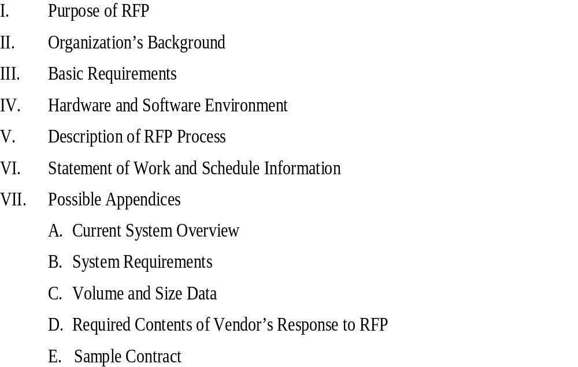
Outline for a Request for Proposal (RFP)
B12 Project Management

Slide 76
Solicitation
Solicitation involves obtaining proposals or bids from prospective sellers
Organizations can advertise to procure goods and services in several ways
  approaching the preferred vendor
  approaching several potential vendors
  advertising to anyone interested
A bidders’ conference can help clarify the buyer’s expectations
B12 Project Management

Slide 77
Source Selection
Source selection involves
  evaluating bidders’ proposals
  choosing the best one
  negotiating the contract
  awarding the contract
It is helpful to prepare formal evaluation procedures for selecting vendors
Buyers often create a “short list”
B12 Project Management

Slide 78
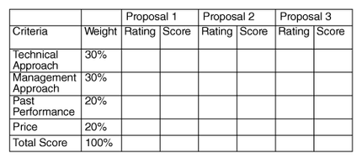
Sample Proposal Evaluation Sheet
B12 Project Management

Slide 79
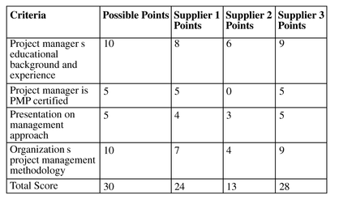
Criteria for Selecting Suppliers
B12 Project Management

Slide 80
Be Careful in Selecting Suppliers and Writing Their Contracts
Many dot-com companies were created to meet potential market needs, but many went out of business, mainly due to poor business planning, lack of senior management operations experience, lack of leadership, and lack of visions. Check the stability of suppliers
Even well-known suppliers can impede project success. Be sure to write and manage contracts well with all suppliers
B12 Project Management

Slide 81
Contract Administration
Contract administration ensures that the seller’s performance meets contractual requirements
Contracts are legal relationships, so it is important that legal and contracting professionals be involved in writing and administering contracts
Many project managers ignore contractual issues, which can result in serious problems
B12 Project Management

Slide 82
Suggestions on Change Control for Contracts
Changes to any part of the project need to be reviewed, approved, and documented by the same people in the same way that the original part of the plan was approved
Evaluation of any change should include an impact analysis. How will the change affect the scope, time, cost, and quality of the goods or services being provided?
Changes must be documented in writing. Project team members should also document all important meetings and telephone calls
B12 Project Management

Slide 83
Project Procurement Management
Project Procurement Management
  Processes required to acquire goods and services from outside the organization
  Discussed from the perspective of the buyer
    Terms and conditions of the contract is a key input to many processes
    Buyer is the customer, thus a key stakeholder
    Seller’s project management team must be concerned with all processes of project management, not just their knowledge area
B12 Project Management

Slide 84
Procurement Planning
  Identify project needs that can best be met by acquiring resources
  Consideration whether to procure, how to, how much, when to purchase
  Subcontractor decisions may provide flexibility
    Internal procurement does not involve formal solicitation and contract
B12 Project Management

Slide 85
Inputs to Procurement Planning
  Scope Statement – boundary for needs and strategies
  Product Description – broad technical issues, not to be confused with a statement of work
  Procurement Resources – formal contracting group (RFP)‏
  Market Conditions – supply and demand, what services are available
  Other Planning Outputs – preliminary cost and schedule, quality management plans, cash flow, WBS, risks, staffing
  Constraints – factors that limit buying options
  Assumptions
B12 Project Management

Slide 86
Project Procurement Management-Tips
Tips from Review Guide
  Make or Buy: consider out of pocket costs and indirect cost of managing procurement
  Buy – to decrease risk (cost, schedule, performance, scope of work)‏
  Make
    Idle plant or workforce
    Retain control
    Proprietary information/procedures
    Buy vs. lease questions (use X = number of days when purchase and lease costs are equal)‏
B12 Project Management

Slide 87
Project Procurement Management
Tips from Review Guide
  Contract Type Selection – reasonable risk between the buyer and seller and greatest initiative for seller’s efficient and economic performance
    Scope – well defined?
    Amount or frequency of changes expected after start date
    Amount of effort and expertise the buyer can devote to manage the seller
    Industry standards
B12 Project Management

Slide 88
Project Procurement Management
Tips from Review Guide
  Cost Reimbursable (CR); seller’s cost are reimbursed; buyer bears highest risk (cost increases)‏
    CPFF – cost plus fixed fee, buyer pays all costs – fee (profit) established
    CPPC – cost plus percentage of costs; bad for buyers (seller not motivated to control costs)‏
    CPIF – cost plus Incentive Fee; seller costs + fee + bonus for meeting/exceeding target (incentive clause)‏
B12 Project Management

Slide 89
Project Procurement Management
Tips from Review Guide
  Time and Materials; priced on per hour basis, elements of fixed price contract and cost reimbursable contracts – buyer has medium risk
  Fixed Price (lump sum, or firm fixed price) - most common (1 price for all work), risk of costs is upon seller
    FPIF – Fixed Price Incentive Fee
    FPEPA – Fixed Price Economic Price Adjustment – long duration projects
  Incentives – help bring seller’s objectives in line with buyer’s
B12 Project Management

Slide 90
Project Procurement Management
Tips from Review Guide
  Incentive Fee and Final Price Calculations
    Must Have:
      Target Cost
      Target Fee
      Target Price
      Sharing Ratio (buyer/seller)‏
      Actual Cost
    Fee = (Target Cost – Actual Cost) x Seller Ratio (%)
    Total Fee = Fee + Target Fee
    Final Price = Actual Cost + Total Fee
B12 Project Management

Slide 91
Project Procurement Management
Tips from Review Guide
  Procurement Documents, Contract Type and Scope of Work
    Request for Proposal – Cost Reimbursable – Performance or Functional Scope (can be somewhat loosely defined)‏
    Invitation for Bid – Time & Materials – Design Scope (moderately defined)‏
    Request for Quotation – Fixed Price – Any Scope (must be detailed)‏
B12 Project Management

Slide 92
Project Procurement Management
Tips from Review Guide
  Terminology (Terms and Conditions)‏
    Force majeure – act of God
    Indemnification – who is liable
    Liquidated damages – estimated damages as a result of contract breach
    Material breach – a breach so large the project may not continue
    Special Provisions – provided by the Project Manager to contracts so that particular needs are addressed
    Privity – contractual relationship
    Single Source – contract directly with preferred seller
    Sole Source – only one supplier available in market
B12 Project Management

Slide 93
Project Procurement Management
Tips from Review Guide
  Evaluation Criteria
    Understanding of need
    Overall or life-cycle cost
    Technical ability
    Management Approach
    Financial Capacity
    Project Management Ability
      Invitation for Bids are usually not evaluated with entire criteria (lowest rate is chosen)‏
B12 Project Management

Slide 94
Project Procurement Management
Tips from Review Guide
  Solicitation
    Bidder’s Conference
      Benefit both buyer and seller
      Watch out for
        Collusion
        Sellers not asking questions in front of their competition
        Make sure all questions and answers are in writing and issued to all sellers (respond to same scope in work)‏
B12 Project Management

Slide 95
Project Procurement Management
Tips from Review Guide
  Source Selection
    Negotiation Objectives
      Obtain a fair and reasonable price
      Development a good relationship with seller
        Project manager must be involved
      Main Terms to negotiate
        Responsibilities
        Authority
        Applicable Law
        Technical and Business Management approaches
        Contract Financing
        Price
B12 Project Management

Slide 96
Project Procurement Management
Tips from Review Guide
  Contract Administration – assure that seller’s performance meets contractual requirements
    Project Managers must understand the contract and manage its completion
      Sometimes contract is in conflict with Scope of Work
      Only the contracting officer (CO) can change contract language
        Often a source of conflict
        Need to deal with a different company’s set of procedures
        It is not as easy to “see” problems
        Greater reliance on reports to determine if a problem exists
        Greater reliance on relationships between buyer and seller’s project managers
B12 Project Management

Slide 97
Project Procurement Management
Tips from Review Guide
  Contract Closeout – more attention to documentation and completion of files
    All documentation must be preserved and filed
    Centralized vs. decentralized contracting
  Contract Interpretation
    Based on analysis of intent
B12 Project Management

